Slide 1
Street Paving
Street Maintenance Funding to Prevent Further Deterioration of Pavement Condition to Save Tax Dollars and Our Streets
Budget and finance Policy committee
COUNCILMEMBER RASHI KESARWANI | APRIL 14, 2022

Slide 2
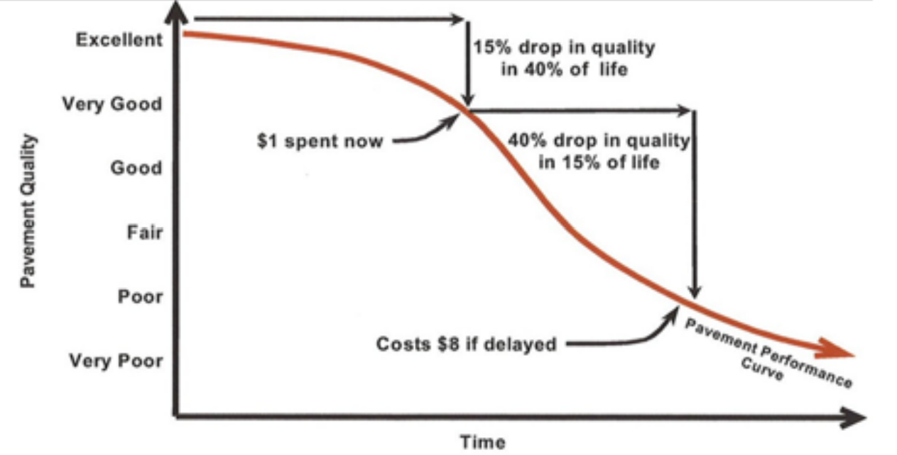
Recommendation
A dollar of maintenance early in a street’s life-cycle saves $8 later due to avoided rehabilitation and/or reconstruction costs associated with failing streets
Allocate minimum of $8 million in additional ongoing annual General Fund—bringing total street paving annual budget to at least $15.1 million—minimum amount needed to maintain pavement condition
Exceed $8 million General Fund need by contributing $3 million in ongoing funds in FY 2022-23 through FY 2024-25 (total of $9 million)
A three-year plan is suggested to give the City time to gradually enhance street paving resources, and annual inflation adjustments are recommended in out-years

Slide 3
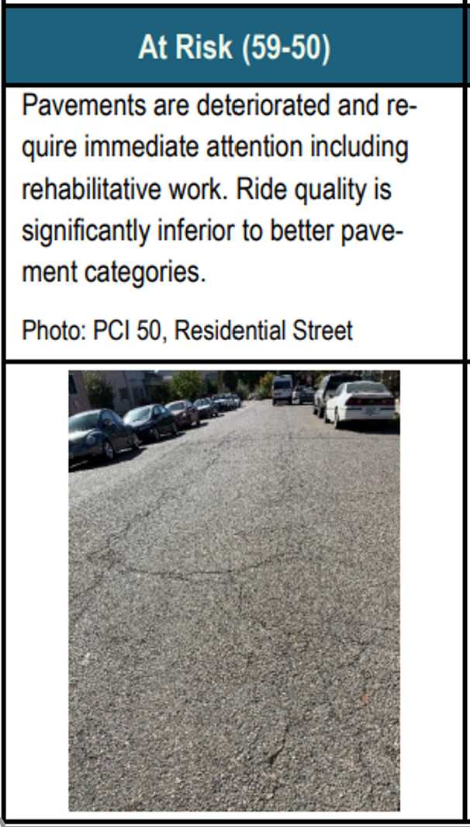
“At Risk” Streets Harm All Users
Berkeley’s streets were rated at an average of 56 out of 100 (Pavement Condition Index) in 2021, meaning they are “at risk”
Drivers pay $1,049 annually (according to TRIP, a national transportation research group) in vehicle repair costs, accelerated vehicle deterioration and depreciation, increased maintenance costs, and additional fuel consumption
Safety concerns for bicyclists and pedestrians who suffer injuries due to potholes and uneven pavement
Source: Berkeley City Auditor, Rocky Road: Berkeley Streets at Risk and Significantly Underfunded, Nov. 19, 2020

Slide 4
Current Street Paving Budget
Funding Source | FY 2013-14 | FY 2014-15 | FY 2015-16 | FY 2016-17 | FY 2017-18 | FY 2018-19 | FY 2019-20 | Total
Non-Recurring Funding | $2.5 | $6.0 | $6.1 | $6.0 | $4.4 |  | $2.8 | $27.8
Measure M | $2.5 | $6.0 | $6.0 | $6.0 | $4.4 |  |  | $24.9
Measure T1 |  |  |  |  |  |  | $2.6 | $2.6
Measure T1 - AAO #1 |  |  |  |  |  |  | $0.3 | $0.3
Successor Agency - WBIP |  |  | $0.1 |  |  |  |  | $0.1
Recurring Funding | $3.5 | $4.0 | $5.2 | $5.2 | $4.3 | $4.9 | $7.0 | $34.1
State Transportation Tax Fund | $0.8 | $0.8 | $0.8 | $0.8 | $0.5 | $0.5 | $0.5 | $4.7
State Transportation Tax Fund - SB1 |  |  |  |  |  |  | $1.5 | $1.5
Measure B | $0.7 | $0.7 | $0.7 | $0.7 | $0.7 | $0.7 | $0.7 | $5.0
Measure BB |  |  | $1.6 | $1.6 | $1.1 | $1.6 | $2.2 | $8.1
Measure F | $0.1 | $0.6 | $0.2 | $0.2 |  | $0.2 | $0.2 | $1.3
Capital Improvement Fund¹ | $1.9 | $1.9 | $1.9 | $1.9 | $1.9 | $1.9 | $1.9 | $13.5
Total | $6.0 | $10.0 | $11.3 | $11.2 | $8.7 | $4.9 | $9.8 | $61.9
One-Time
Ongoing
General Fund
¹Capital Improvement Fund is from the City’s General Fund.
Source: Berkeley City Auditor

Slide 5
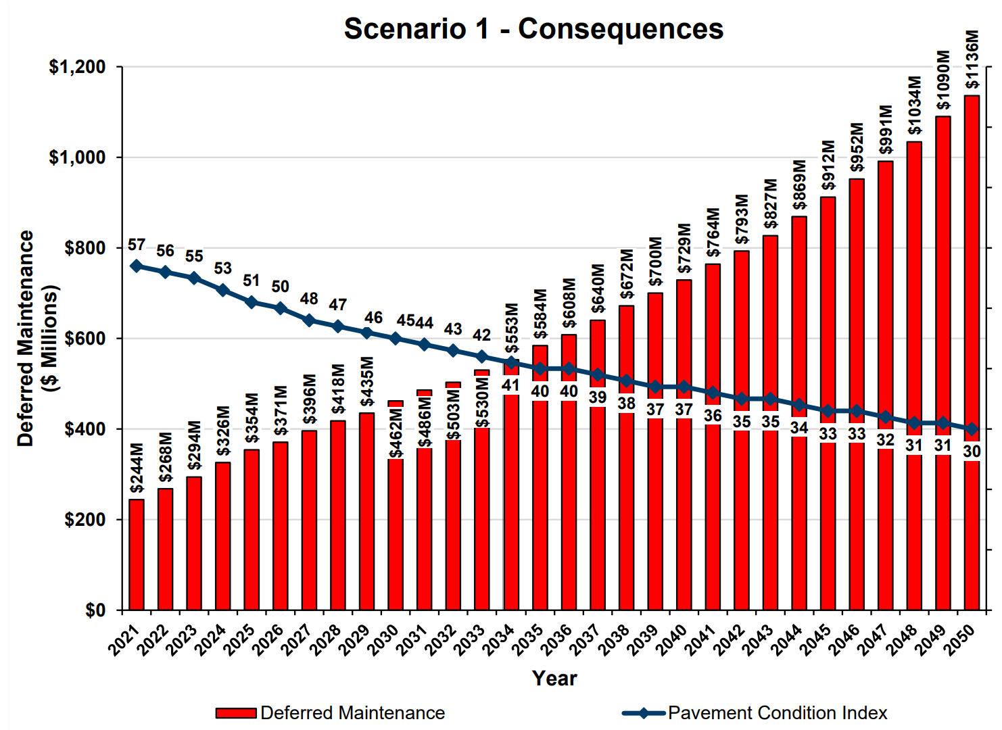
Deferred Street Maintenance
With current street paving budget, deferred maintenance grows to more than $1 billion by 2050
Source: Pavement Engineering Inc., City of Berkeley 2020/21 Pavement Management System Update, p. 10, Jan. 2021

Slide 6
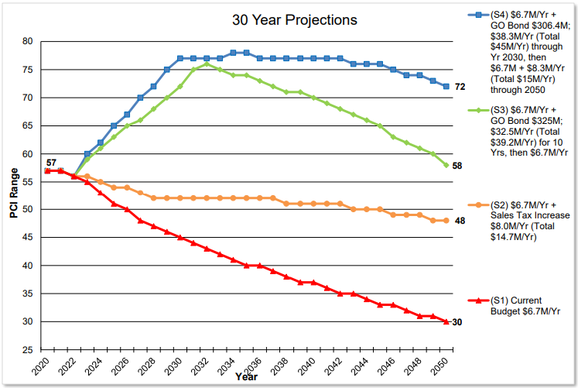
Importance of Maintenance Funds
A large revenue measure without adequate maintenance funds only temporarily stalls pavement condition decline (see S3, green line)
Source: Pavement Engineering Inc., City of Berkeley 2020/21 Pavement Management System Update, p. 9, Jan. 2021

Slide 7
Lessons Learned from Measure M
Measure M funding of $30 million fell short of need ($54 million) and lack of additional maintenance funding means the measure only temporarily stalled decline in pavement condition
Measure M (2012) raised $30 million in general obligation bond funds for street maintenance, falling short of the $54 million of identified deferred maintenance
About 75 to 85 percent of the $30 million went toward street paving, with the remaining funds paying for Complete Streets improvements (sidewalk repair, green infrastructure, as well as bike and pedestrian improvements)
City should be aware of the additional costs associated with green infrastructure as well as the Bicycle Plan and Pedestrian Plan when planning and budgeting for deferred street maintenance (sidewalk repair now funded separately)
Source: Berkeley City Auditor, Rocky Road: Berkeley Streets at Risk and Significantly Underfunded, Nov. 19, 2020

Slide 8
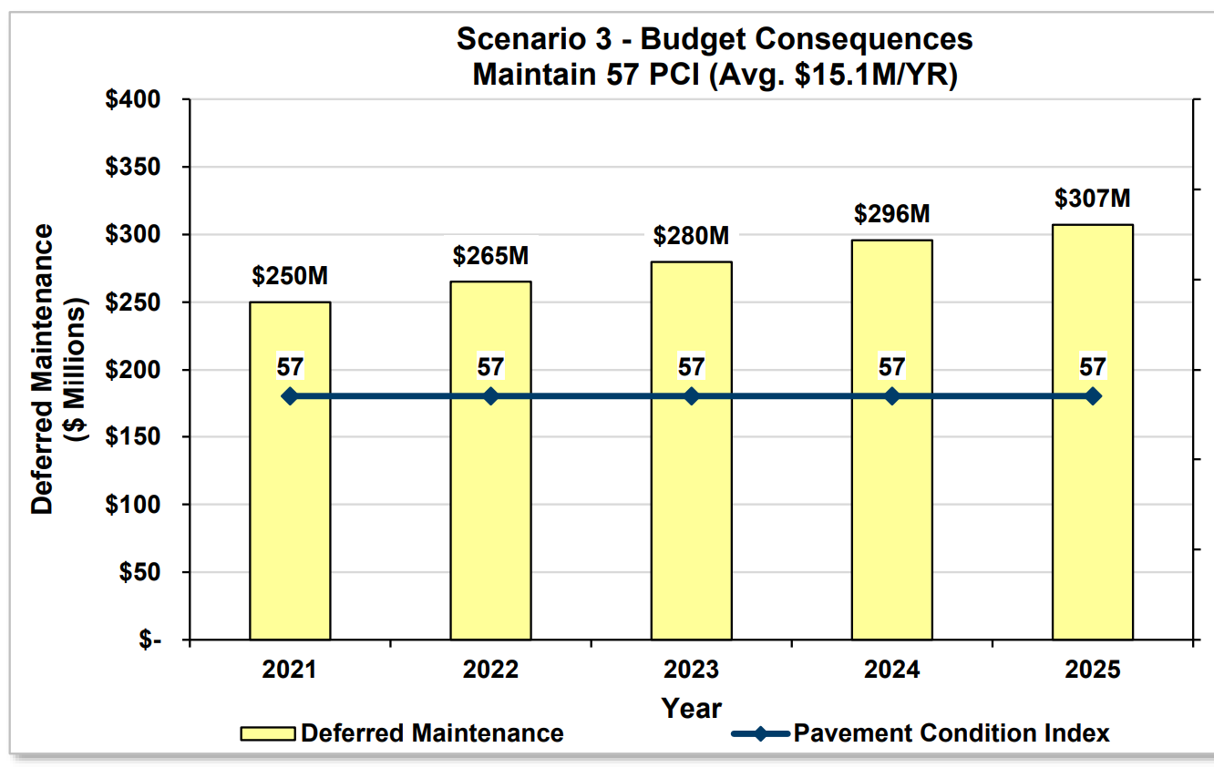
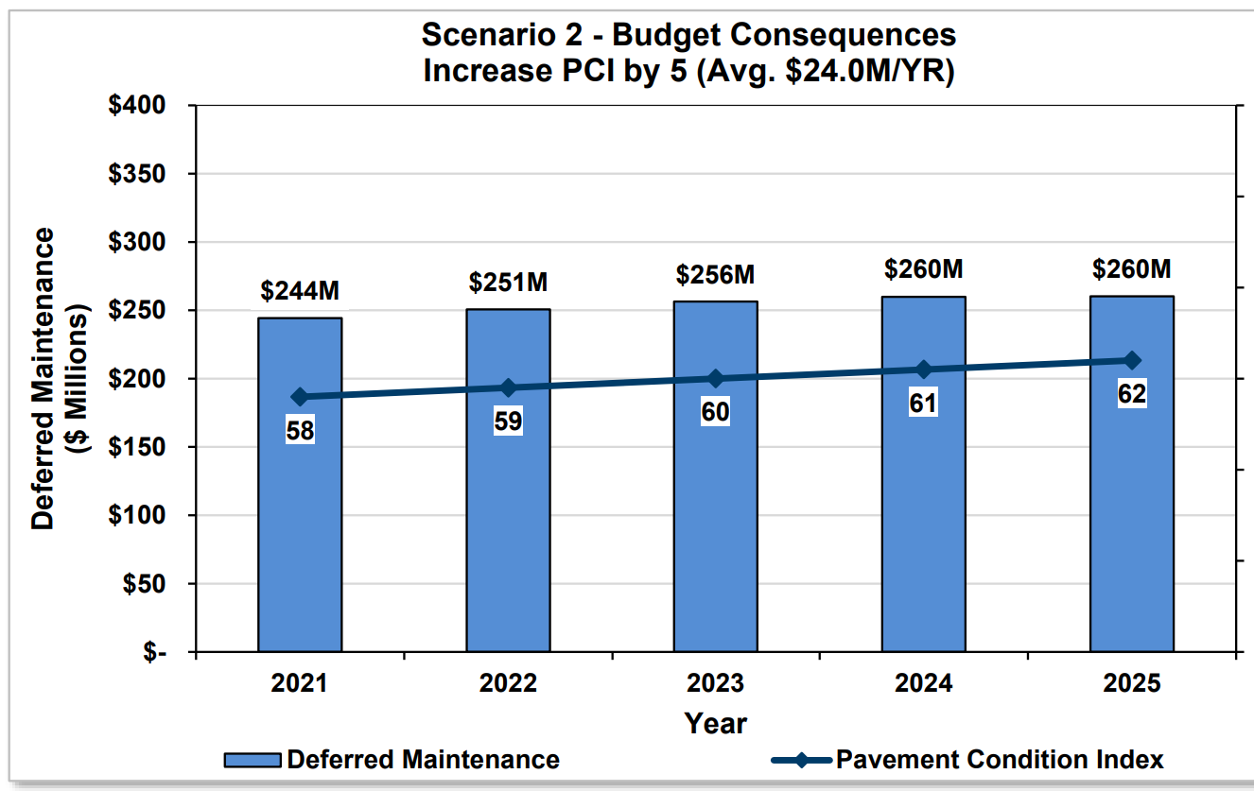
Maintaining v. Improving Pavement Condition
Source: Pavement Engineering Inc., City of Berkeley 2020/21 Pavement Management System Update, p. 8, Jan. 2021

Slide 9
Discussion Councilmember Rashi Kesarwani rkesarwani@cityofberkeley.info or 510-981-7110

